Slide 1
Struts 2.0
Servlet api expose the HTTP client to java platform

Slide 2
Features
Benefit
Internalization
It is new architecture.
Validation
Learning curve less
Spring Integration
No Form bean
It is plug-in architecture.
Simplified Tag library
Tiles
OGNL support
Easy for Unit Test

Slide 3
ActionContext
Value Stack
It is expression language.
OGNL
It is for common, corss-cutting task
It may be JSP/FreeMaker/Velocity /JSON/XML.
Result
Interceptors
FilterDispatcher( it is servlet filter )

Slide 4
Configuration
XML file
Configure application specific resources actions/ results/interceptors /
annotation
Configure application specific resources actions/ results
Struts.properties
Fine tune struts framework

Slide 5
Action
Pass through Action
Action interface
ActionSupport
Set of AWARE interfaces

Slide 6
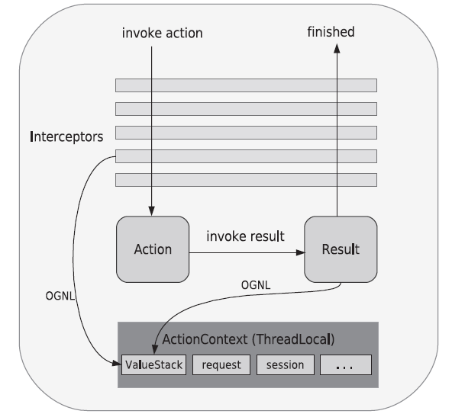

Slide 7
Result can be either JSP or servlet url path
Dispatcher(default)
RestultType
redirect
redirectAction

Slide 8
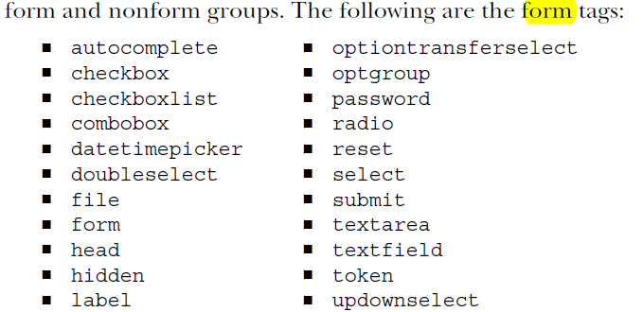
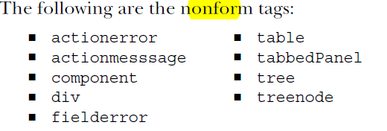

Slide 9
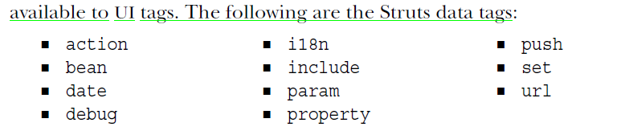

Slide 10
Spring integration
Put one entry in web.xml
We can specify different location for applicationContext.xml file, but its optional
Create applicationContext.xml

Slide 11
Spring integration
Use Autowire
Not to Use Autowire
Use of autowire. No need to declare action class in spring configuration file. Auto wiring happending by “name” by default.
We have to declare action classes in spring configuration file. This is not recommended.
To change default auto wiring add entry in struts.properties or <constant> in strut XML configuration file

Slide 12
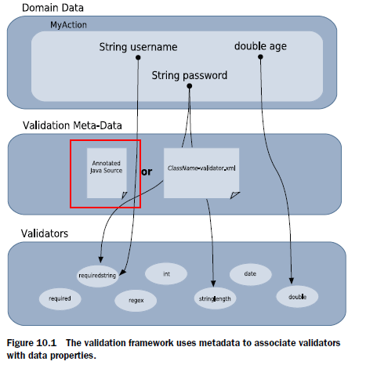
Validation Framework is implemented as Interceptor
Validation (interceptor)
ValidationAware
go for validation framework when u want to reuse the validation logic in different places
go for Basic validation for action specific validation, like already exist of a record
Xwork
Non-field validation, ( we can use the same for already exist validation)

Slide 13
Validator
Field Validator
Non – field Validator
Validation Per- domain object
Validators.xml file application scoped validator file and put it in root class path along with application scoped message properties file and struts.properties file
Validation Per Action object
Validation Per alias-Action object
We use “workflow” interceptors excludeMethods to avoid validation for certain methods of action or use SkipValidation annotation
Validation Per Context-Action object

Slide 14
Internationalization
We can set Locale object.
It is Locale Sensitive object.
ResourceBundle
PropertyResourceBundle
CoustomeResourceBundle
We write our class to load message from even DB instead of Properties file.

Slide 15
Resource Bundle selection
Message property file per Action class
Message property file per Model if action implement ModelDriven class
SuperClass-Action.properties
Message property file per package of Action class
Interfaces-Action.properties
Message property file per application (need entry in struts.properties)
Action-Class.properties

Slide 16
Local selection without boundary of specific bundle
Default resource bundle specified in struts.properties or a constant in struts action
Configuration file
<constant name="struts.custom.i18n.resources" value="global-messages" />
It act as default properties file, if current locale specific property file is not found.
Somebase.properties
This is Local hierarchy
Somebase_en.properties
Somebase_ru.properties
These are language specific properties file

Slide 17
Customize type conversion error message in default file.
Use <il8n> tag
Parameter message
OGNL expression
Native java support

Slide 18
Change default locale
This is set by il8n interceptor for every request
The same locale object is set in session scope by il8n interceptor the key is WW_TRANS_I18N_LOCALE.
Local
ActionContext

Slide 19
Tiles integration
Make <listener> entry In web.xml
Make <context-param> entry In web.xml
Make a new <result-type> in struts.xml
Create Tiles defintion file
Create one base template JSP file used tiles tag library
Use tiles-definition logical name in struts <result> tag

Slide 20
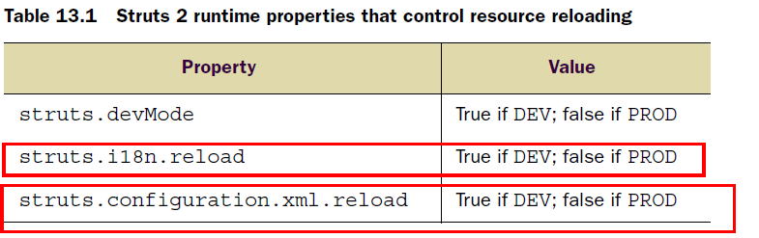
Development environment
Junit test
ActionProxy
Action itself

